Slide 1
angular

Slide 2
Prerequirement
Softwares:
1.Node js -> search in google and download
2.Angular cli -> npm install -g@angular/cli
cli -> command line interface
Check version of node and npm, to cross verify
3. editor -> visual studio code
Knowledge:
Basics of js

Slide 3
version -> 1.2.3
1 -> major release
2 ->minor release
3 ->patch
7.2.11

Slide 4
npm install -g @angular/cli
ng new my-dream-app
cd my-dream-app
ng serve / npm start

Slide 5
Command to start/run -> npm start / ng serve
ng new my-dream-app
Ng g c component-name
Package.json -> dependencies, dev dep, modules,scripts
Flow? Main.ts -> app.module-> app.component.ts -> app.component.html

Slide 6
localhost:4200
default port
Package.json -> dependencies, dev dep, modules,scripts
Flow? Main.ts -> app.module-> app.component.ts -> app.component.html

Slide 7
Issue
https://stackoverflow.com/questions/58032631/why-powershell-does-not-run-angular-commands

Slide 8
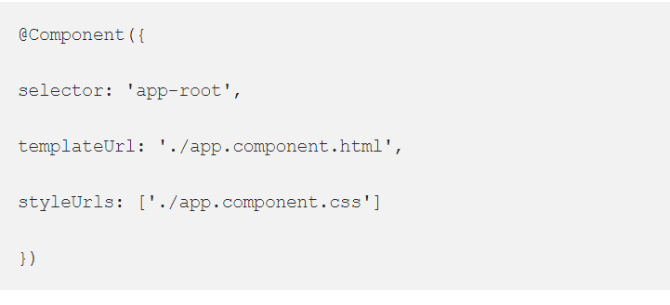
Metadata
Metadata in angular tells a javascript class, how it should be processed on screen. Usually we will pass meta data in the decorator’s.

Slide 9
Module
Component
Service
Metadata

Slide 10
MODULE
ANGULAR -> COLLECTION OF MODULES
EG: USERMODULE, ADMIN MODULE ETC
ROOTMODULE -> ??AppModule
MODULE CAN BE EXPORTED/IMPORTED
MODULE -> MADE UP OF COMPONENTS AND SERVICES
module -> represent feature area in application Eg: usermodule
module = component+services

Slide 11
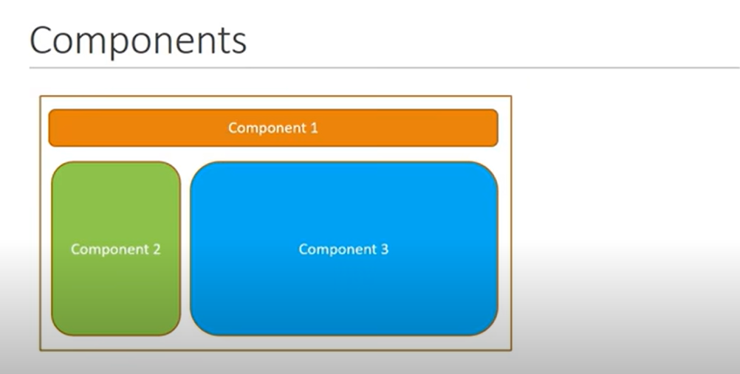

Slide 12
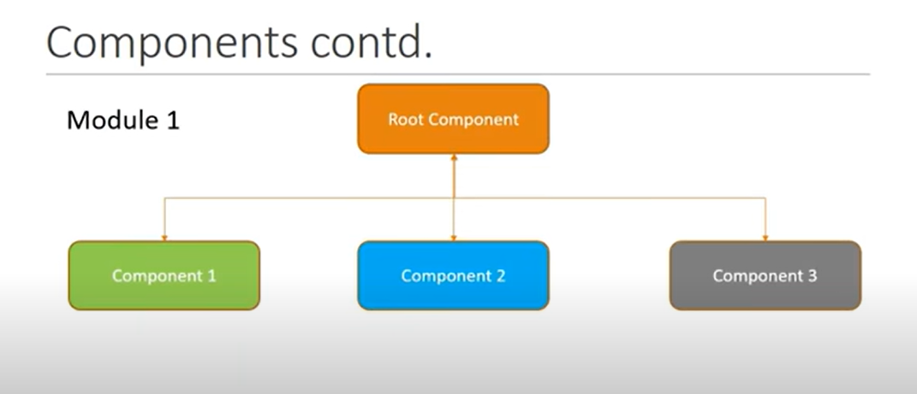

Slide 13
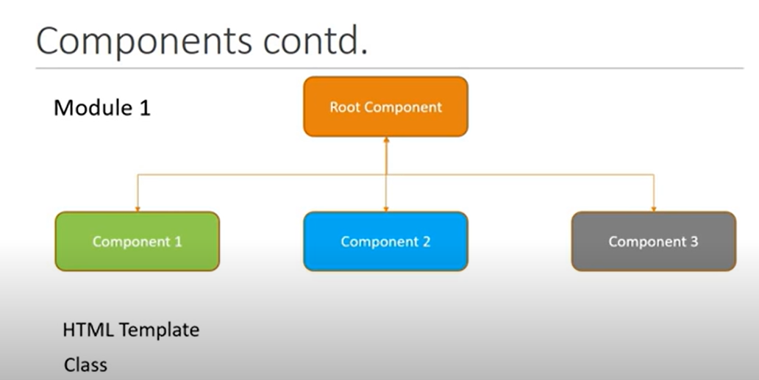

Slide 14
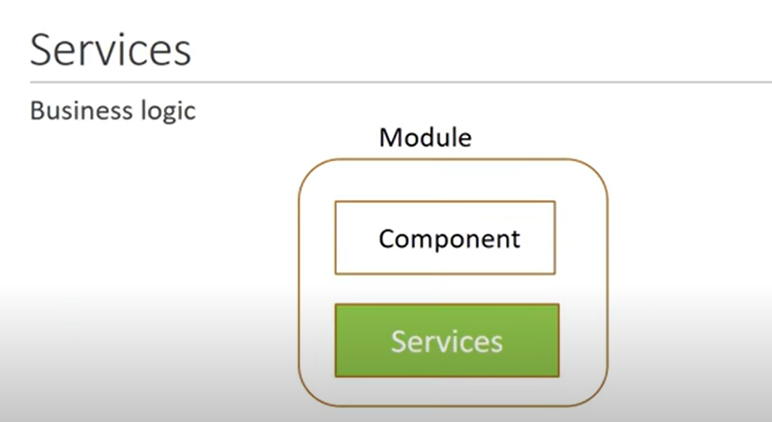

Slide 15
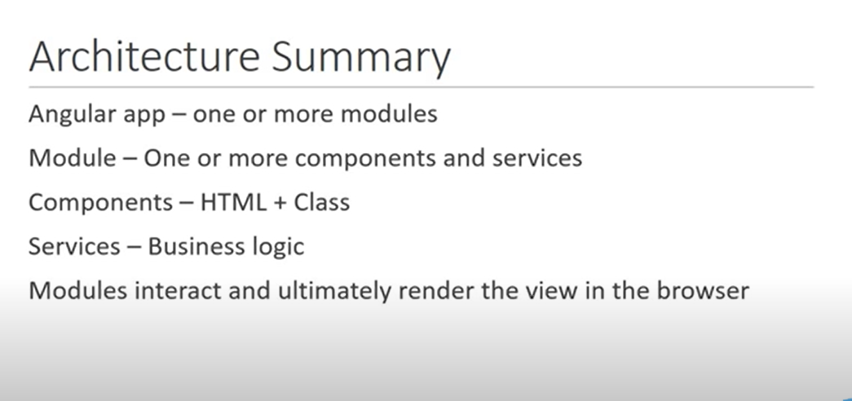

Slide 16
@Component({
selector: '.app-test',
templateUrl: './test.component.html', -> html
styleUrls: ['./test.component.css'] -> css file
})
Interpolation -> binding data of class to template {{ }}
{{name }}->html
name = ‘user20’ in class

Slide 17
Property binding

Slide 18
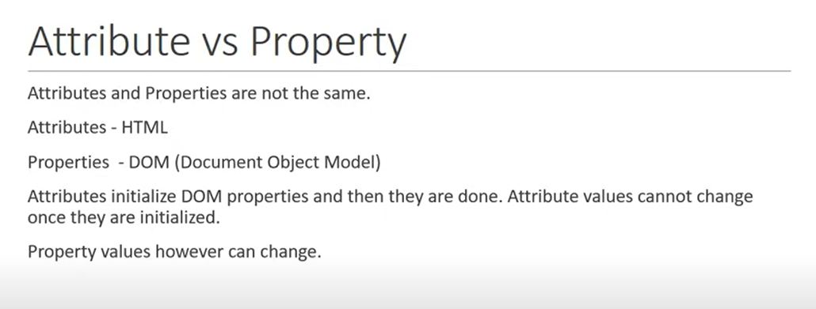

Slide 19
Selector -> custom html tag , that can be used to represent this component
1
selector: 'app-test',
<app-test></app-test>
2. selector: '.app-test',
<div class = 'app-test'></div>
3.
selector: '[app-test]',
<div app-test></div>

Slide 20
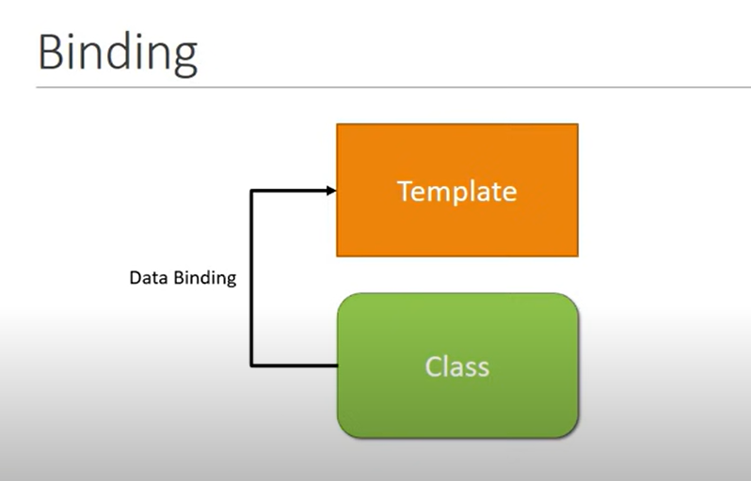

Slide 21
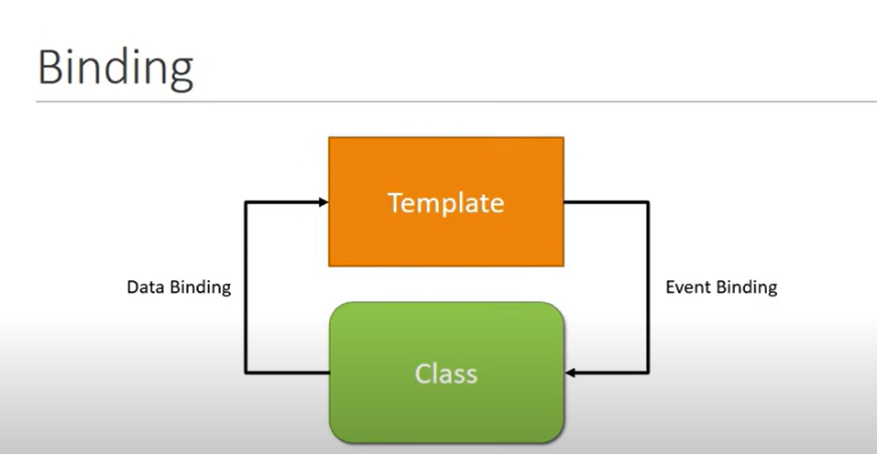

Slide 22
Event type

Slide 23
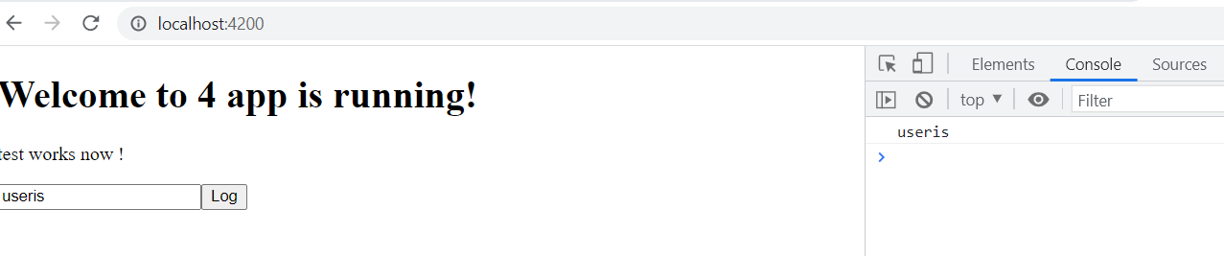
Template Reference Variables
Want some data to flow from template to class Eg: to do some validations
<input #myInput type ="text">
<button (click)="logMessage(myInput.value)" >Log</button>
logMessage(value){
console.log(value);
}

Slide 24
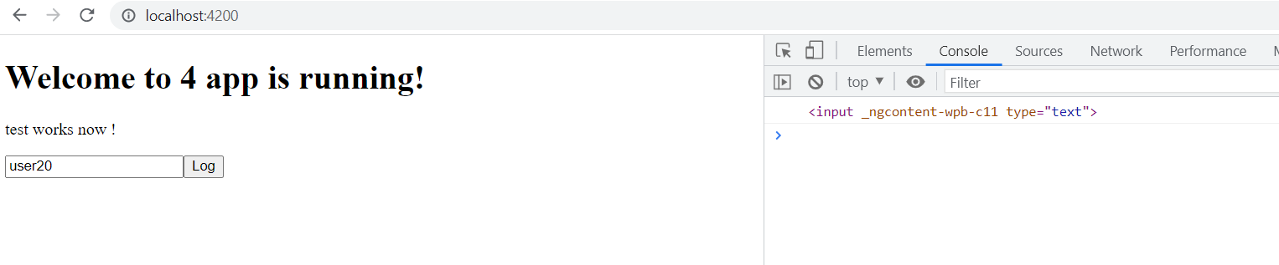
Input
<input #myInput type ="text">
<button (click)="logMessage(myInput)" >Log</button>
logMessage(value){
console.log(value);
}

Slide 25
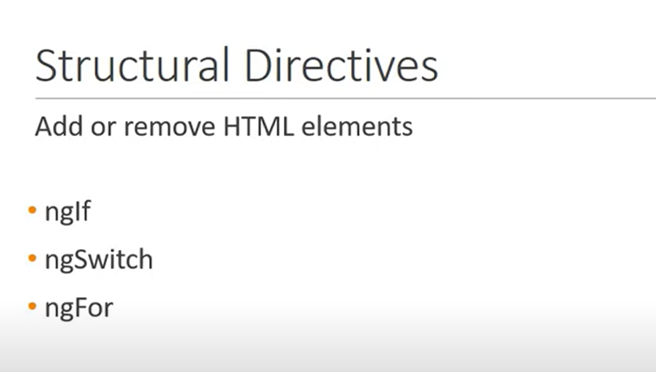

Slide 26
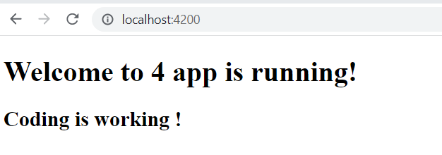
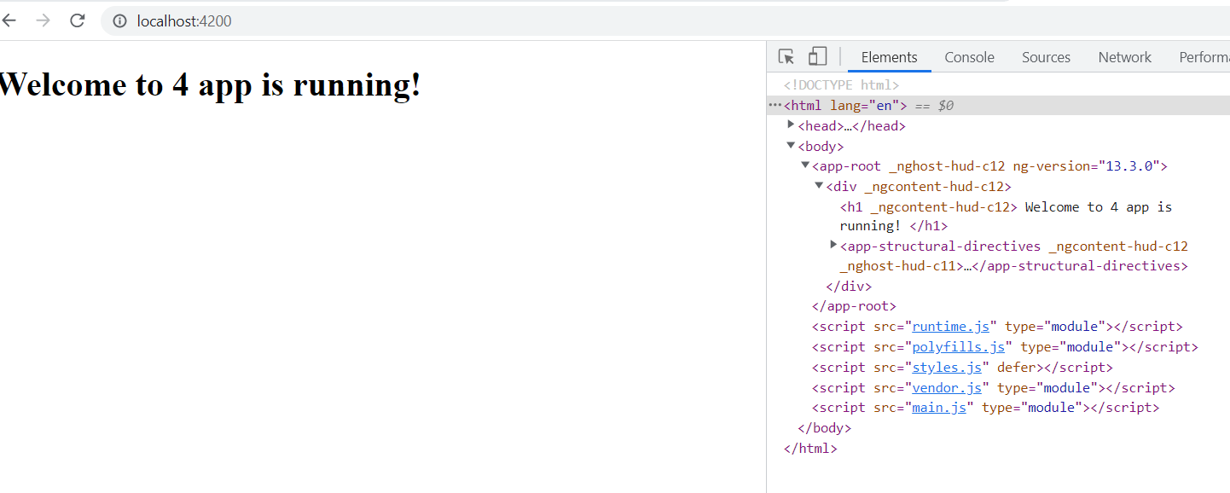
Created new project for understanding purpose 1.ng g c structural-directives2.add <app-structural-directives></app-structural-directives> in component.html
<h2 *ngIf = "true">
Coding is working !
</h2>
<h2 *ngIf = "false">
Coding is working !
</h2>
REMOVED FROM DOM ITSELF.IT’S DIFF FROM DISPLAY NONE

Slide 27
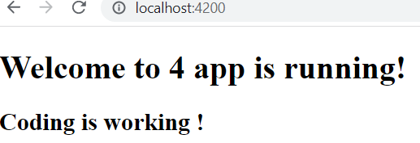
Assigning to a property
<h2 *ngIf = "displayName">
Coding is working !
</h2>
Ts:
displayName = true;
Toggle displayName as true & false, and check output

Slide 28
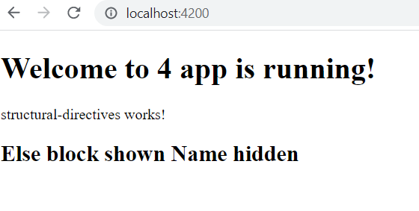
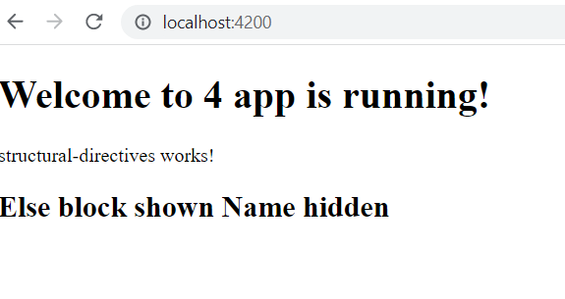
Else tag Another way
<h2 *ngIf="display; else elseBlock">
Coding is working !
</h2>
<ng-template #elseBlock>
<h2>
Else block shown Name hidden
</h2>
</ng-template>
TS file
display = false;
<div *ngIf="display; then thenBlock; else elseBlock"></div>
<ng-template #thenBlock>
<h2>Coding is working !</h2>
</ng-template>
<ng-template #elseBlock>
<h2> Else block shown Name hidden</h2>
</ng-template>
TS file
display = false;

Slide 29
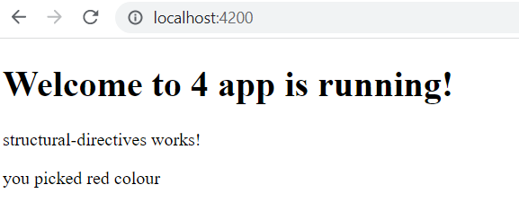
Ng switch - Compare with multiple conditions
<div [ngSwitch] = "color">
<div *ngSwitchCase="'red'"> you picked red colour</div>
<div *ngSwitchCase="'blue'"> you picked blue colour</div>
<div *ngSwitchCase="'green'"> you picked green colour</div>
<div *ngSwitchDefault>Pick again</div>
</div>
TS:
color= "red";

Slide 30
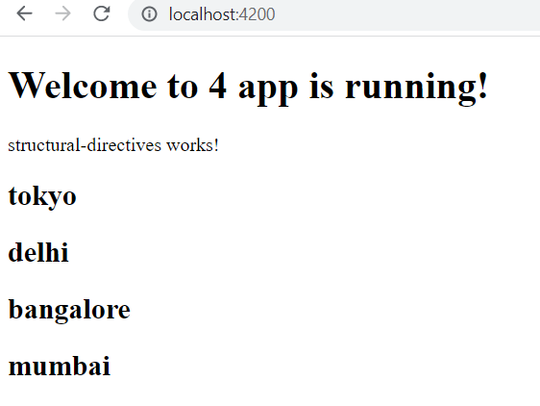
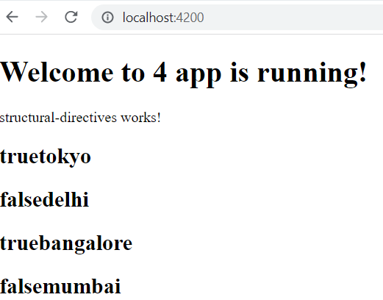
ngFor-> to retrieve elements one by one
Even try odd
public cities=["tokyo","delhi","bangalore","mumbai"];
HTML:
<div *ngFor = "let city of cities">
<h2>{{city}}</h2>
</div>
public cities=["tokyo","delhi","bangalore","mumbai"];
HTML:
<div *ngFor = "let city of cities; even as e">
<h2>{{e}}{{city}}</h2>
</div>

Slide 31
first,last index
public cities=["tokyo","delhi","bangalore","mumbai"];
HTML:
<!-- <div *ngFor = "let city of cities; first as f">
<h2>{{f}}{{city}}</h2>
</div> -->
public cities=["tokyo","delhi","bangalore","mumbai"];
HTML:
<!-- <div *ngFor = "let city of cities; index as i">
<h2>{{i}}{{city}}</h2>
</div> -->

Slide 32
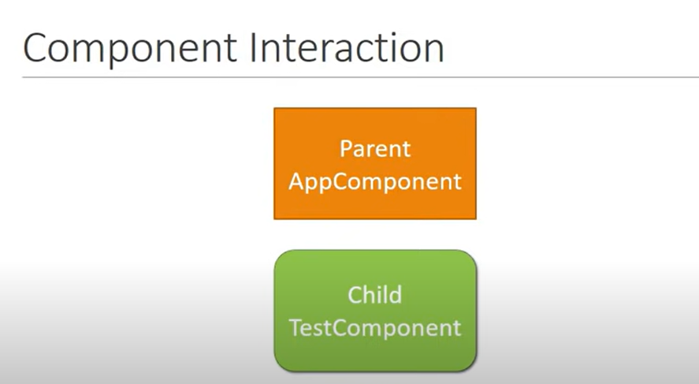

Slide 33
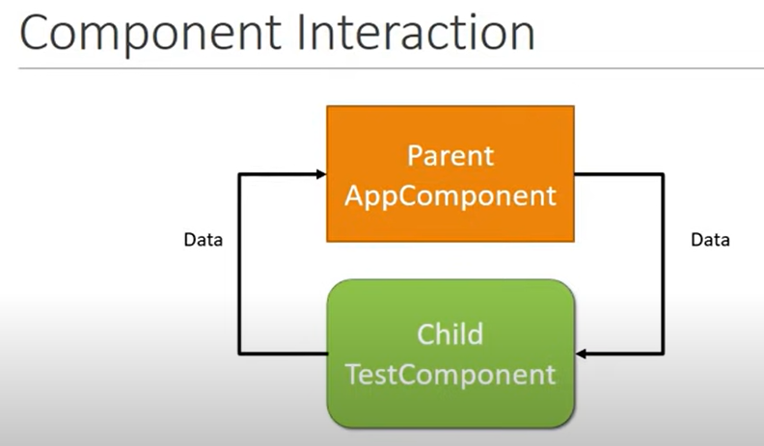

Slide 34
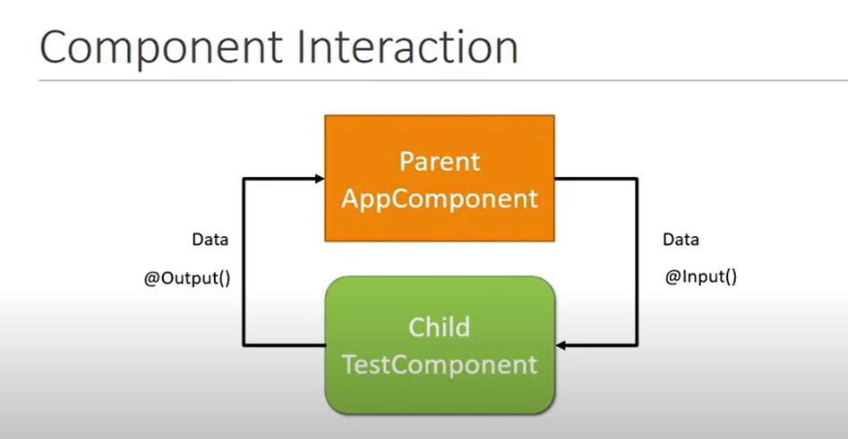

Slide 35
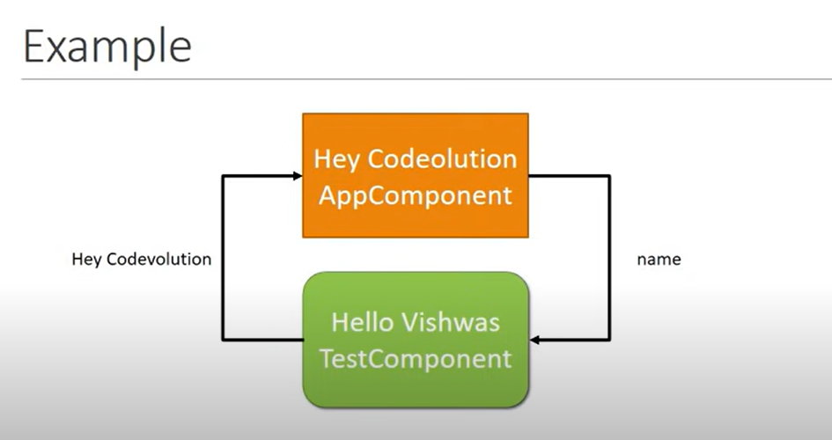

Slide 36
Parent to child
Parent ts:
public laptopName = "thinkPad";
Parent html:
<app-test [parentData] = "laptopName"></app-test>
Child html:
<h2>{{"hello" + newLaptopName}}</h2>
Child ts:
@Input('parentData')
public newLaptopName;

Slide 37
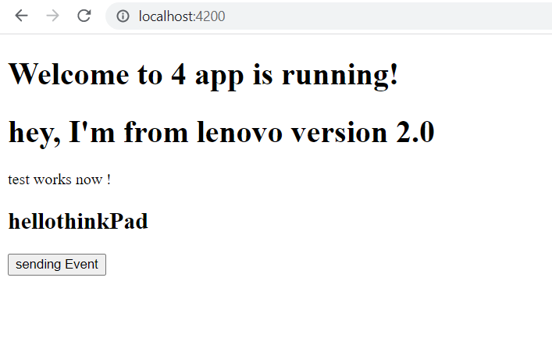
Child to parent
Child.ts
@Output()
public childEvent = new EventEmitter();
fireEvent(){
this.childEvent.emit("hey, I'm from lenovo version 2.0");
}
Child.html
<button (click)="fireEvent()">sending Event</button>
parent.ts
public messageIs = "";
parent.html
<app-test (childEvent) = "messageIs=$event" [parentData] = "laptopName"></app-test>

Slide 38
PIPES: transform data before displaying in view only
TS file
public name ="here is code"
public person = {
"firstName" :"hello",
"lastName" : "user24"
}
public date = new Date();
Html:
{{name}}
<h2>{{name | lowercase}}</h2>
<h2>{{name | uppercase}}</h2>
<h2>{{name | titlecase}}</h2>
<h2>{{name | slice:3}}</h2>
<h2>{{name | slice:3:8}}</h2>
<h2>{{person | json}}</h2>
<h2>{{0.25 | percent}}</h2>
<h2>{{0.25 | currency}}</h2>
<h2>{{0.25 | currency : 'GBP'}}</h2>
<h2>{{0.25 | currency : 'GBP':'code'}}</h2>
<h2>{{5.678 | number : '1.2-3'}}</h2>
<h2>{{5.678 | number : '3.4-5'}}</h2>
<h2>{{5.678 | number : '3.1-2'}}</h2>
<h2>{{15.3245 | number : '2.2-3'}}</h2>
<h2>{{15.3245 | number : '2.2-5'}}</h2>
<h2>{{15.3245 | number : '2.5-7'}}</h2>
{{date}}
<h2>{{date | date :'short'}}</h2>
<h2>{{date | date :'shortDate'}}</h2>
<h2>{{date | date :'shortTime'}}</h2>
<h2>{{date | date :'medium'}}</h2>

Slide 39
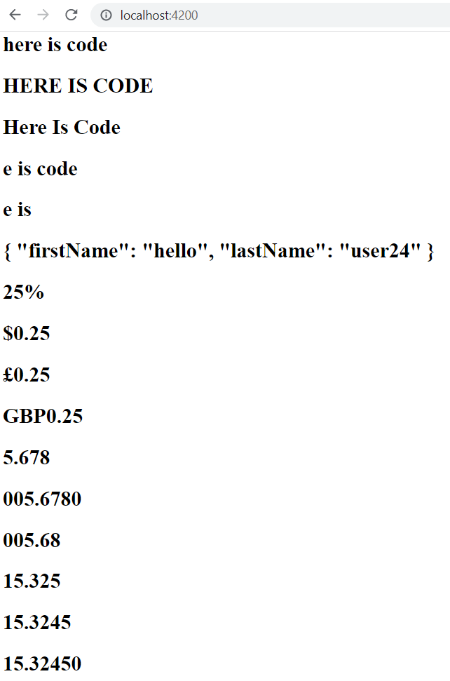
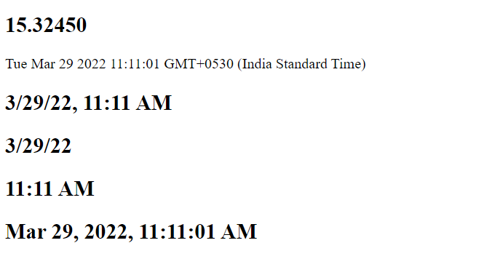

Slide 40
services

Slide 41
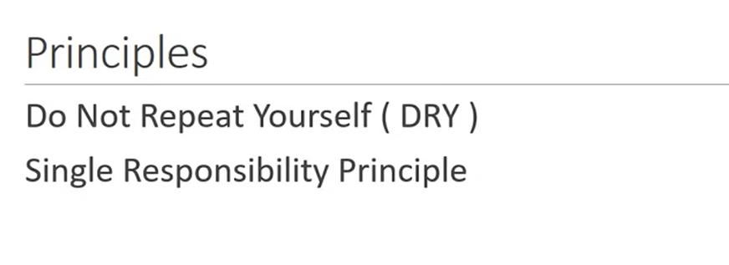

Slide 42
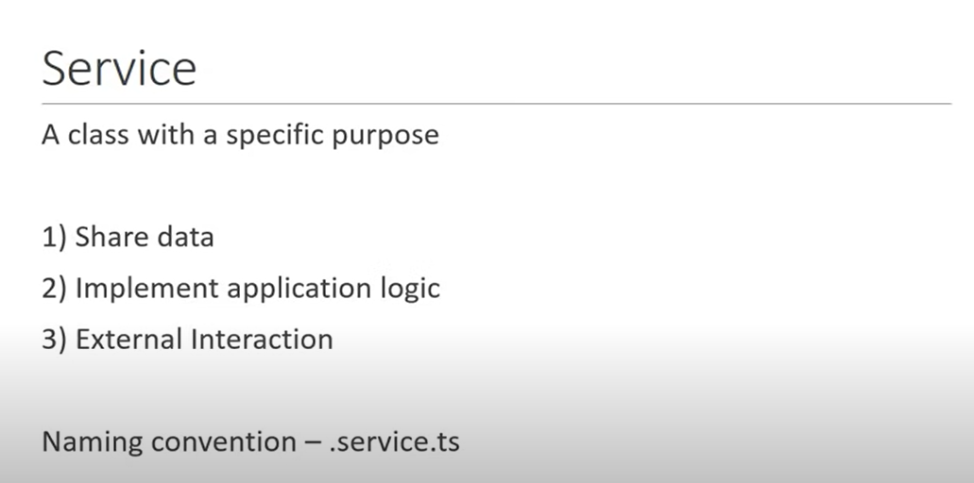

Slide 43
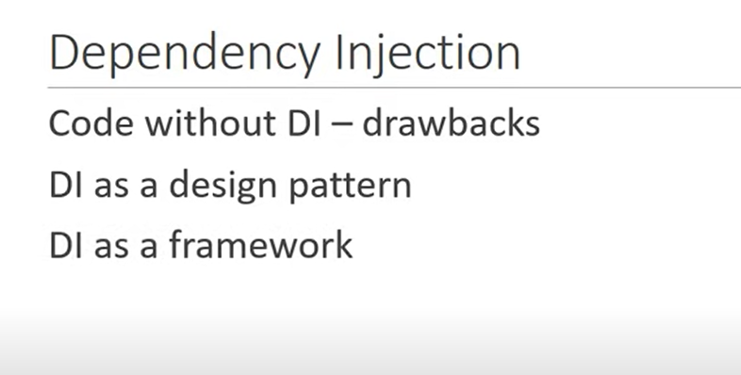

Slide 44
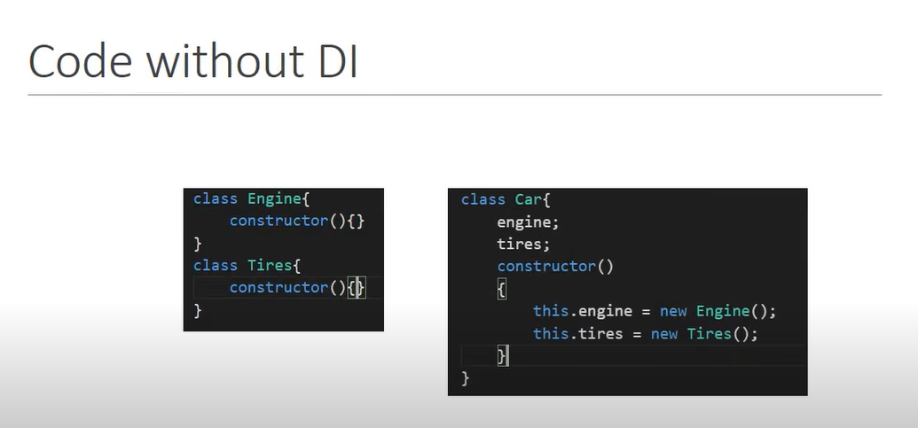

Slide 45
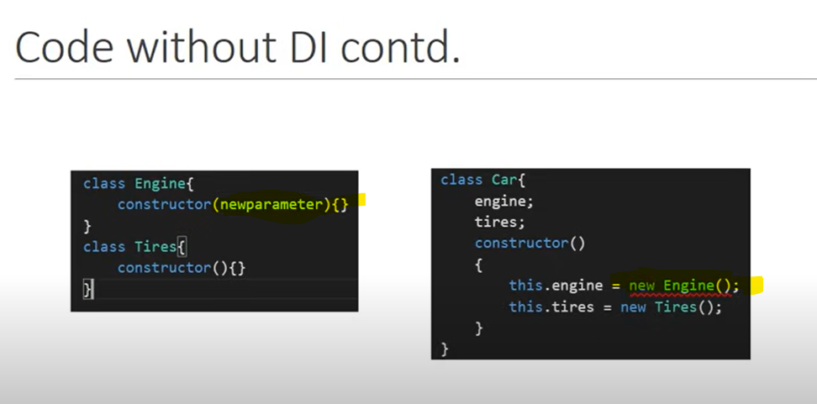

Slide 46
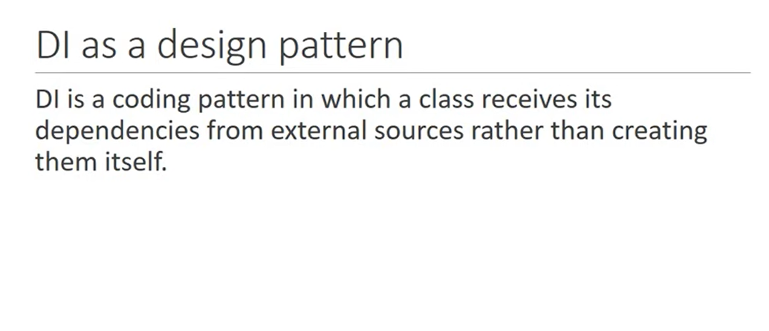

Slide 47
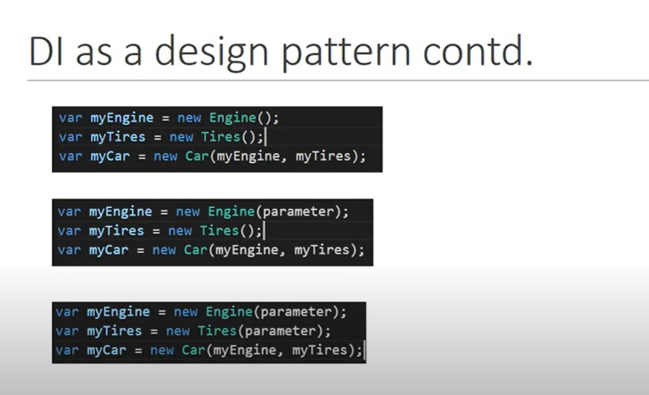

Slide 48
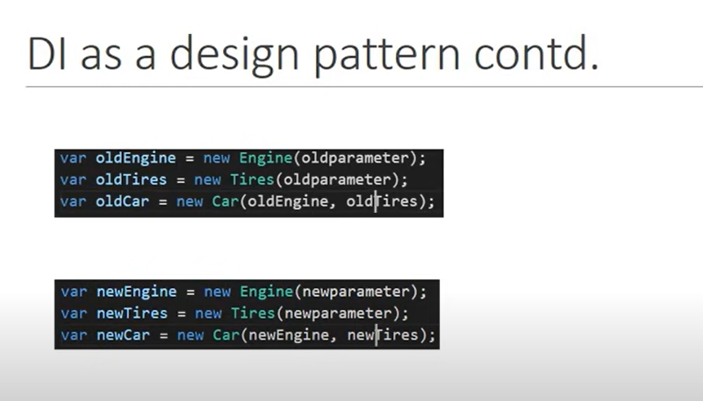

Slide 49
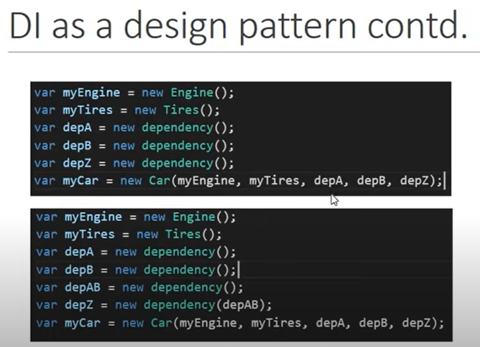
What if u have 10 dependencies?

Slide 50
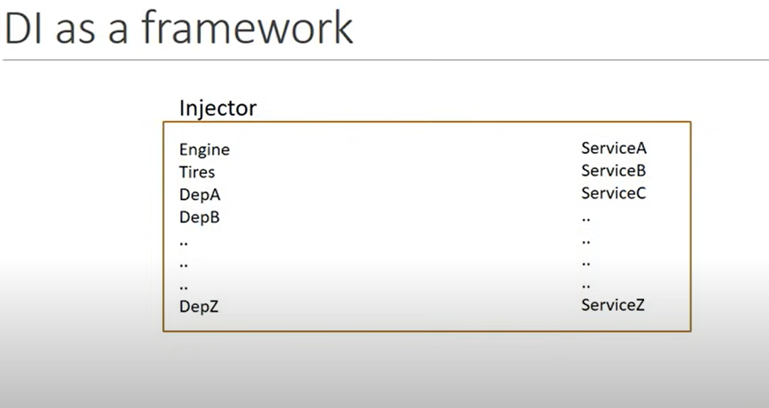

Slide 51
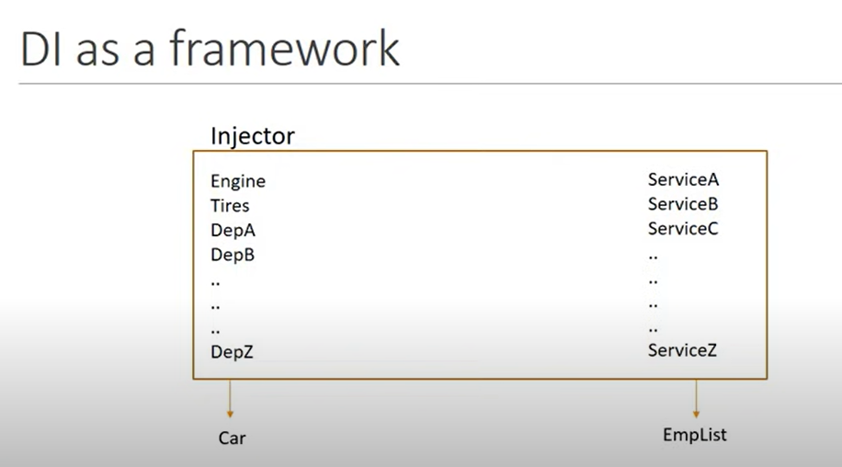

Slide 52
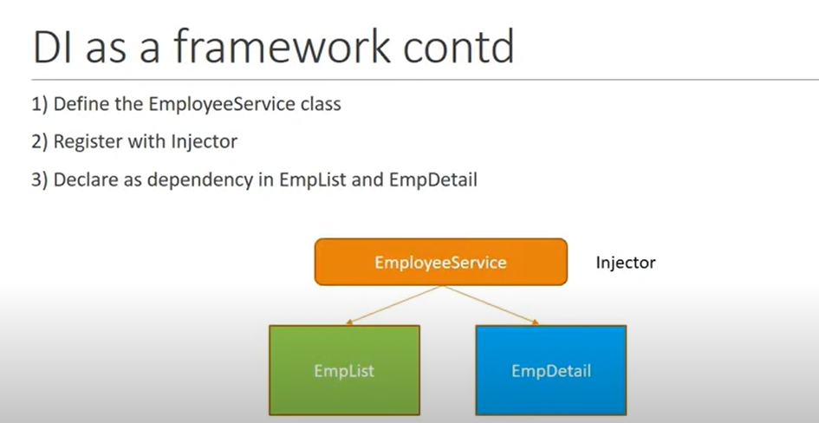

Slide 53
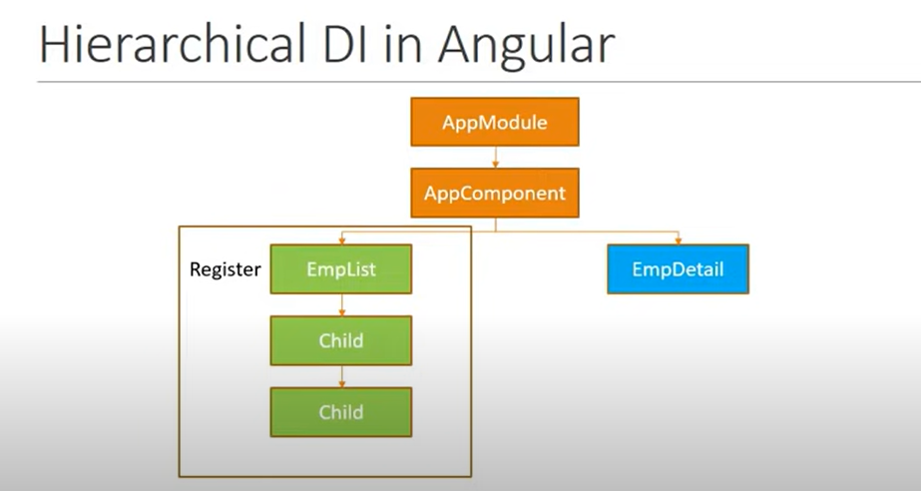

Slide 54
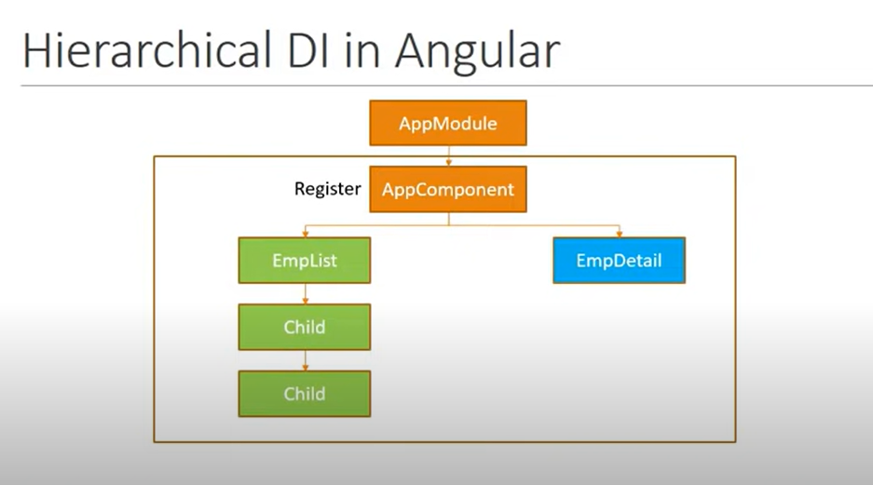

Slide 55
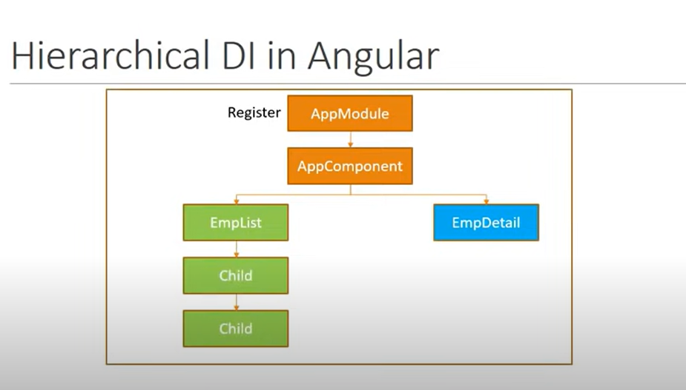

Slide 56
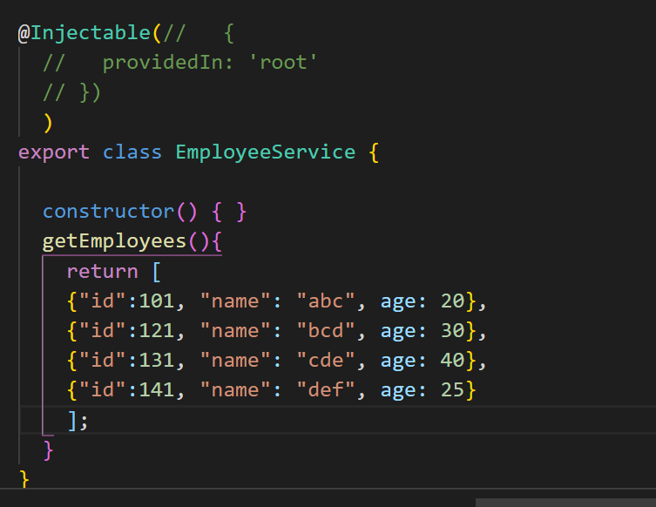
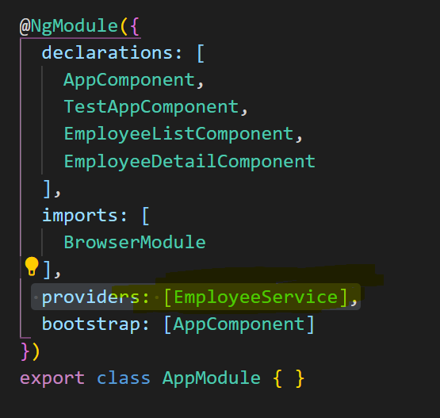
Create emp service
In appmodule.ts

Slide 57
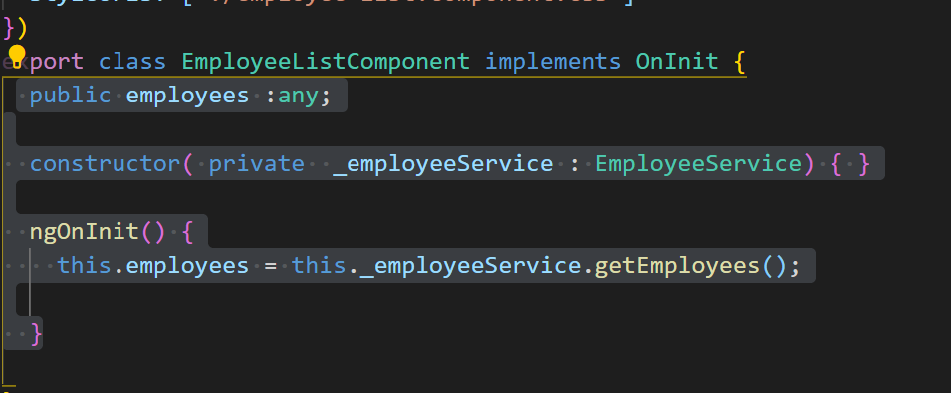
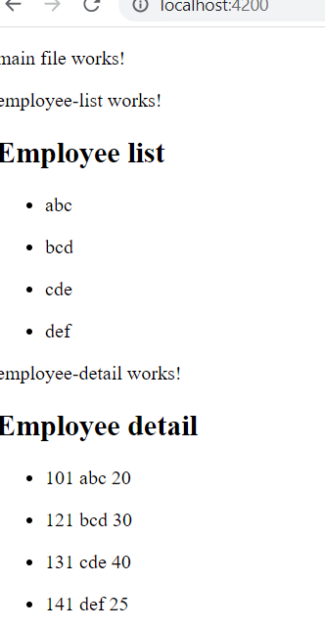
Same for employeelist and employeedetail

Slide 58
HTTP and Observables

Slide 59
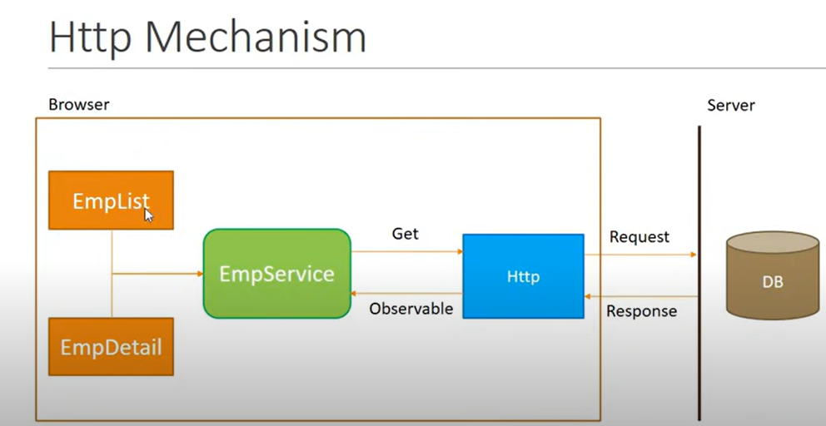

Slide 60
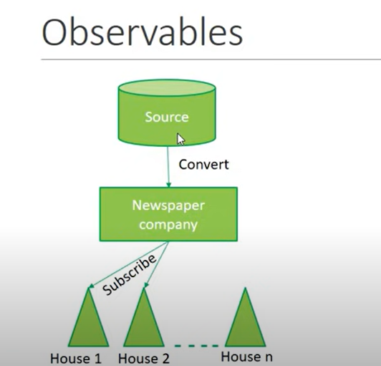

Slide 61
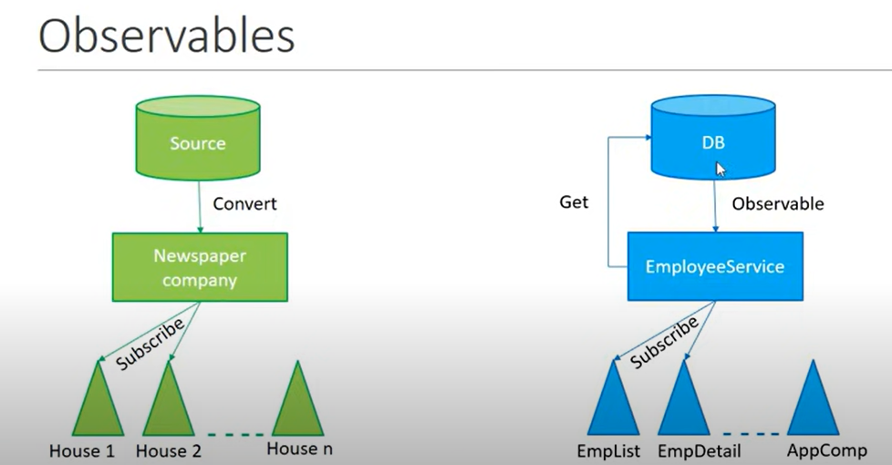

Slide 62
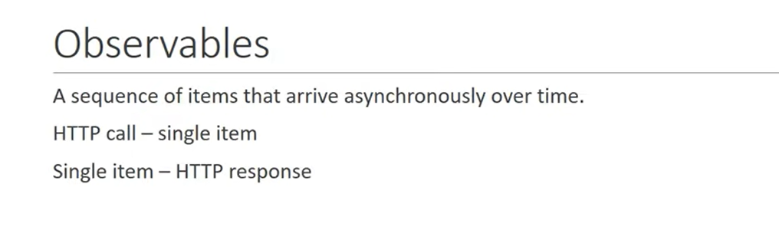

Slide 63


Slide 64


Fetch Data Using HTTP
Appmoduole.ts so, that http module is used for appmodule.
We are also registering http service with angular injector, we don’t have to explicitly declarate it in metadata
Employee service
We are ready to make getrequest to fetch data using HTTP

Slide 65



Slide 66


Slide 67


Now, 2nd step

Slide 68


emplist

Slide 70



Angular Tutorial - HTTP Error Handling
We need catch operator

Slide 71


Now, display it in emplist, empdetail
Both in emp list and emp detail

Slide 72


Slide 73


Slide 74


Slide 75
https://angular.io/guide/router-tutorial
Ng new routing-demo –routing
Ng g c department-list , ng g c employee-list
approutingmodule.ts
const routes: Routes = [
{path: 'departments' ,component: DepartmentListComponent},
{ path: 'employees' ,component: EmployeeListComponent}
];
export const routingComponents = [DepartmentListComponent,EmployeeListComponent]

Slide 76
4. With button
<nav>
<a routerLink ="/departments" routerLinkActive="active">Departments</a>
<a routerLink ="/employees" routerLinkActive="active">Employees</a>
</nav>
Css:
/* You can add global styles to this file, and also import other style files */
nav a.active{
color: aqua;
/* margin-left: 10px; */
}
nav a{
padding: 5px 10px;
}

Slide 77

Wildcard Route
Wrong url na, error shown
Ng g c page-not-found -it -is
In pagecomponent, <h3>pagenot found <h3>
In app-routing-module.ts -> {path : “**” , component:PageNotFoundComponent}
Add to routingcomponents as well
Note: pagenotfound path must be inlast always

Slide 78

Default route
{path: '' ,component: DepartmentListComponent},

Slide 79
Redirecting to default route: best way
{path: '' ,redirectTo: '/departments',pathMatch:'prefix'}
{path: '' ,redirectTo: '/departments',pathMatch:'full'}
Full works for us :)

Slide 80


Slide 81
In deplistcomponent.ts
departments = [
{"id": 1,"name":"Angular"},
{"id": 2,"name":"Node"},
{"id": 3,"name":"MongoDB"},
{"id": 4,"name":"Ruby"},
{"id": 5,"name":"Bootstrap"}
]
HTML:
<h3>
Department List
</h3>
<ul class="items">
<li *ngFor="let department of departments">
<span class = "badge">{{department.id}}</span>
{{department.name}}
</li>
</ul>
Deplist html
/* items class */
.items {
margin: 0 0 2em 0;
list-style-type: none;
padding-left: 0;
width: 10em;
}
.items li {
cursor: pointer;
position: relative;
left: 0;
background-color: #EEE;
margin: .5em;
padding: .3em;
height: 1.6em;
border-radius: 4px;
}
.items li:hover {
color: #607D8B;
background-color: #DDD;
left: .1em;
}
.items li.selected:hover {
background-color: #BBD8DC;
color: white;
}
.items .text {
position: relative;
top: -3px;
}
.items li {
cursor: pointer;
position: relative;
left: 0;
background-color: #EEE;
margin: .5em;
padding: .3em;
height: 1.6em;
border-radius: 4px;
}
.items .badge {
display: inline-block;
font-size: small;
color: white;
padding: 0.8em 0.7em 0 0.7em;
background-color: #607D8B;
line-height: 1em;
position: relative;
left: -1px;
top: -4px;
height: 1.8em;
margin-right: .8em;
border-radius: 4px 0 0 4px;
}
.items li.selected {
background-color: #CFD8DC;
color: white;
}

Slide 82


Slide 83
Now, wat i need is, when i click any item, url should change to department/id
Create new component ng g c department-detail -it -is
After created, let’s add a route to navigate to that component
app-routingmodule.ts
{ path: 'departments/:id', component: DummyDetailComponent },
Add in routingComponents also
HTML:
<h3>
Department List
</h3>
<ul class="items">
<li (click)=”onSelect(department)” *ngFor="let department of departments">
<span class = "badge">{{department.id}}</span>
{{department.name}}
</li>
</ul>

Slide 84

TS:
onSelect(department){
//this.router.navigate(['/departments', department.id]);
this.router.navigate([department.id], { relativeTo: this.route });
}
constructor(private route: Router)

Slide 85
Dept detail.ts
import { ActivatedRoute } from '@angular/router';
constructor(private route: ActivatedRoute) { }
//let id = parseInt(this.route.snapshot.paramMap.get('id'));
this.departmentId = id;
public departmentId;
<h3>You selected department with id = {{departmentId}}</h3>

Slide 86
Quick overview
https://medium.com/bycodegarage/building-blocks-of-angular-eafbb289b6d6

Slide 87
What is the difference between attributes and properties?
The difference is subtle.
Attributes are referring to additional information of an object.
Properties are describing the characteristics of an object.
Most people use these two words as synonyms.

Slide 88
Is it [()] or ([])? How will I remember?
The DOM is the side that is displayed (outside), and the component is internal (inside) — So, the squared brackets will be outside :)

Slide 89
https://cupofcode.medium.com/the-main-building-blocks-of-an-angular-application-explained-cup-of-angular-part-1-dce71c88d449

